Slide 1

Wrap-up
https://unsplash.com/de/fotos/7BpeiA0bhxs

Slide 2
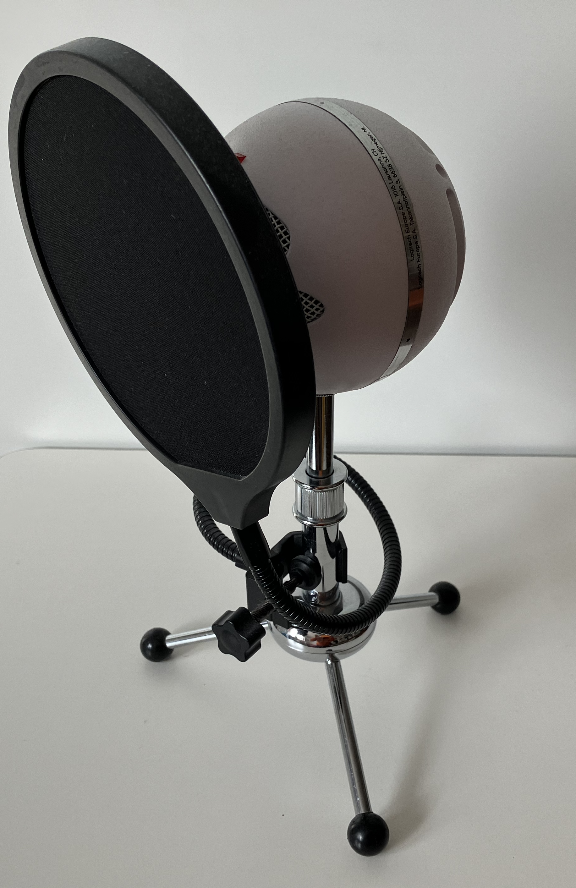
How has it been?
Please share your thoughts.

Slide 3

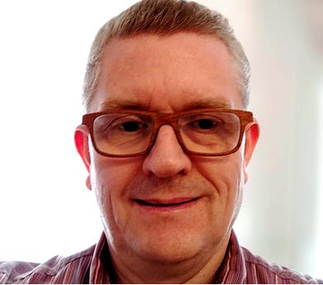







@tkuenneth
@tkuenneth
@tkuenneth
@tkuenneth@androiddev.social

Slide 4

Thank you Thomas Künneth
https://unsplash.com/photos/M3fhZSBFoFQ

